Slide 1


GRAPH THEORY

Slide 2


Slide 3

A graph G consists of two finite sets:
  a nonempty set V(G) of vertices.
  a set E(G) of edges, where each edge is associated with a set consisting of either one or two vertices called its endpoints.
  f is a function, called an incidence function, that assign to each edge, , a one element subset {v} or two elements subset {v , w}, where v and w are vertices.
We can write G as (V, E, f ) or (V, E ) or simply as G.

Slide 4
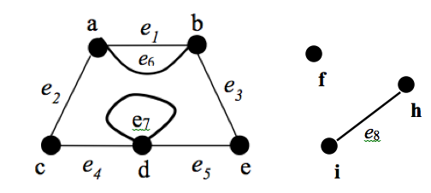
Example 1
Given a graph as shown below,
e₉
e₁₀
Write a vertex set and the edge set, and give a table showing the edge-endpoint function.
Find all edges that are incident on a, all vertices that are adjacent to a, all edges that are adjacent to e₂, all loops, all parallel edges, all vertices that are adjacent to themselves and all isolated vertices.
Note: Solution – Refer module

Slide 5
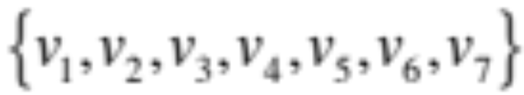
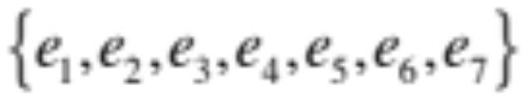
Example 2
Let,
  V =
  E =
And f be defined by:
  f(e₁) =f(e₂) ={v₁ ,v₂}
  f(e₃) ={v₄ ,v₃}
  f(e₄) =f(e₆) =f(e₆) ={v₆ ,v₃}
  f(e₅) = {v₂ ,v₄}
Question: What is the pictorial representation of G?
* Solution – refer module (Fig. 4.5)

Slide 6


Slide 7
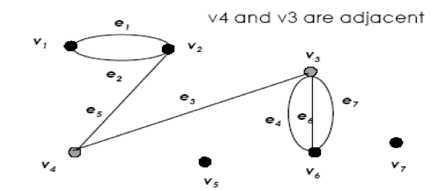
Adjacent Vertices
Two vertices that are connected by an edge are called adjacent; and a vertex that is an endpoint of a loop is said to be adjacent to itself.
Example

Slide 8
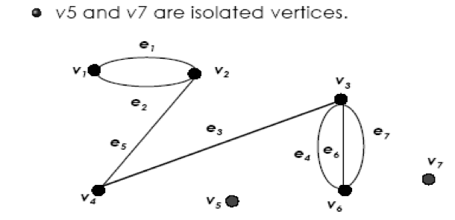
Isolated Vertex
Let G be a graph and v be a vertex in G. We say that v is an isolated vertex if it is not incident with any edge.
Example

Slide 9
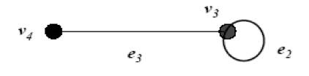

Loop
An edge with just one endpoint is called a loop.
Example

Slide 10
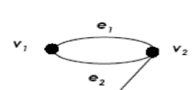
Parallel Edges
Two or more distinct edges with the same set of endpoints are said to be parallel.
e₁ and e₂ are parallel.
Example

Slide 11


Slide 12
Let G be a graph and v be a vertex in G.
The degree of v, written deg(v) or d(v) is the number of edges incident with v.
Each loop on a vertex v contributes 2 to the degree of v.

Slide 13
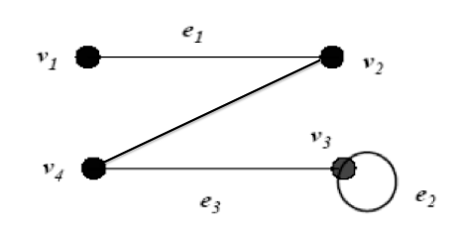
Example
State the degree of each vertex for the following graph.
deg(v₁ )= 1; deg(v₂)= 2; deg(v₃)= 3; deg(v₄)= 2

Slide 14
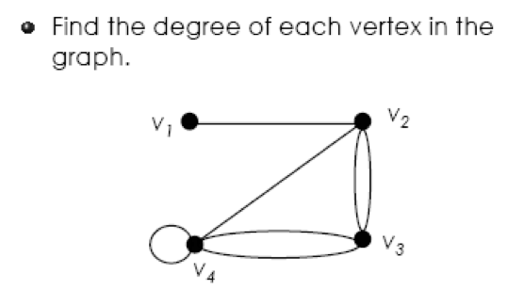
Exercise

Slide 15
Exercise - Solution
Solution: deg(v₁ )= 1; deg(v₂)= 4; deg(v₃)= 4; deg(v₄)= 5

Slide 16


Slide 17
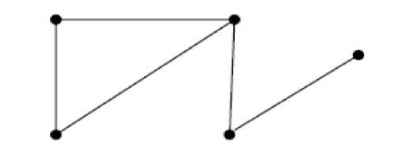
Simple Graph
A graph G is called a simple graph if G does not contain any parallel edges and any loops.
Example

Slide 18
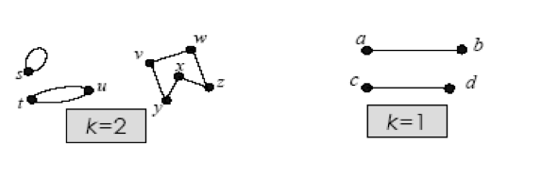
Regular Graph
Let G be a graph and k be a nonnegative integer. G is called a k-regular graph if the degree of each vertex of G is k.
Example
Fig.1: Graph A
Fig.2: Graph B

Slide 19
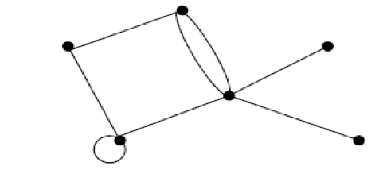

Connected Graph
A graph G is connected if given any vertices v and w in G, there is a path from v to w.
Example
Fig.1: Connected graph
Fig.2: Not connected graph

Slide 20
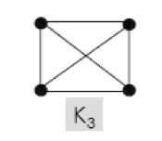
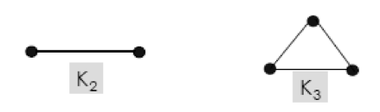
Complete Graph
A simple graph with n vertices in which there is an edge between every pair of distinct vertices is called a complete graph on n vertices. This is denoted by k_{n} .
Example
K₄

Slide 21
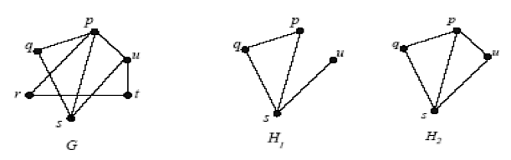
Subgraph
A graph H is said to be a subgraph of a graph G if, every vertex in H is also a vertex in G, every edge in H is also an edge in G, and every edge in H has the same endpoints as it has in G.
Example

Slide 22


Slide 23
To write programs that process and manipulate graphs, the graphs must be stored, that is, represented in computer memory.
A graph can be represented (in computer memory) in several ways.
2-dimensional array: adjacency matrix and incidence matrix.

Slide 24
Adjacency Matrix
Let G be a graph with n vertices.
The adjacency matrix, A_{G} is an nxn matrix [a_{ij}] such that,
a_{ij}= the number of edges from v_{i} to v_{j}, {undirected G}
or,
a_{ij}= the number of arrows from v_{i} to v_{j}, {directed G}
for all i, j = 1,2,….., n.

Slide 25
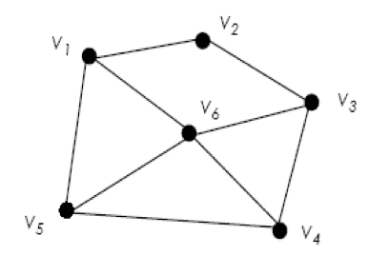
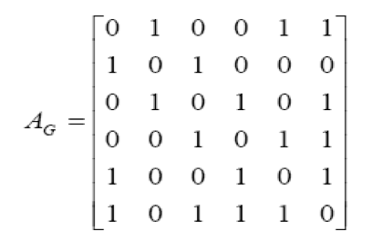
Example 1
[Matrix]
V₁ V₂ V₃ V₄ V₅ V₆
{Graph}
V₁
V₂
V₃
V₄
V₅
V₆
A_{G} =

Slide 26
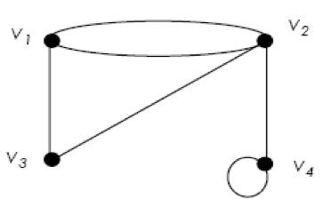
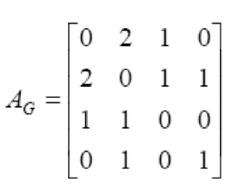
Example 2
{Graph}
V₁ V₂ V₃ V₄
[Matrix]

Slide 27
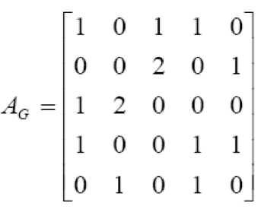
Example 3
Draw the graph based on the following matrix:

Slide 28
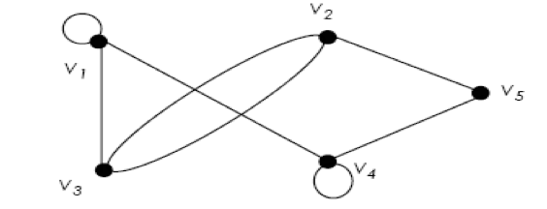
Example 3 - Solution

Slide 29
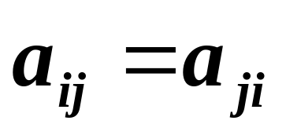
Adjacency matrix is a symmetric matrix if it is representing an undirected graph, where
If the graph is directed graph, the presented matrix is not symmetrical.

Slide 30
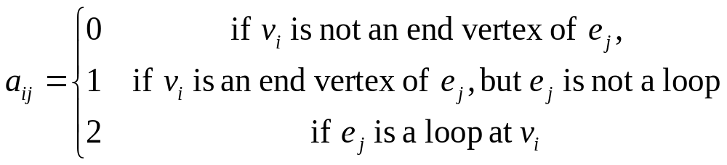
Incidence Matrix
Let G be a graph with n vertices and m edges.
The incidence matrix, I_{G} is an nxm matrix [a_{ij}] such that,

Slide 31
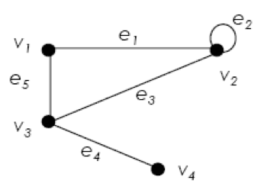
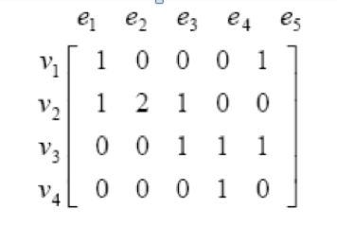
Example
{Graph}
deg(v₁ )= 2;
deg(v₂)= 4;
deg(v₃)= 3;
deg(v₄)= 1
[Matrix]
Notice that the sum of the i-th row is the degree of v_{i}.

Slide 32
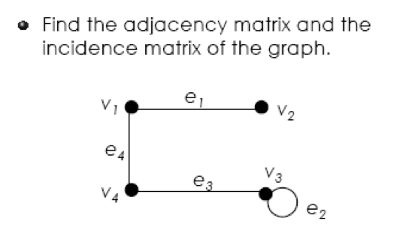
Exercise

Slide 33
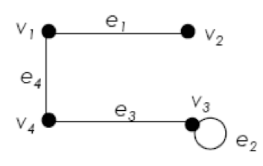


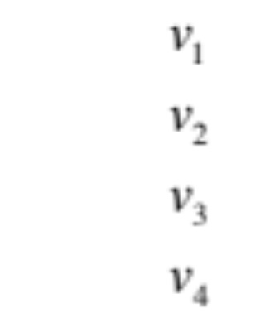
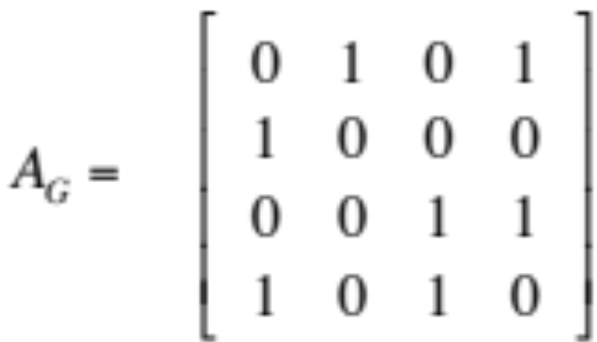
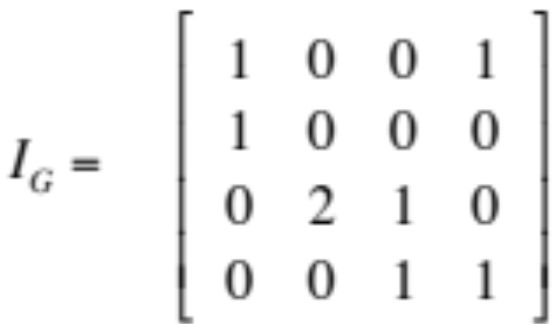
Exercise - Solution
Adjacency matrix
Incidence matrix

Slide 34

Exercise
Past Year 2015/2016

Slide 35
Exercise Solution
Past Year 2015/2016
Fifi
Putih
Jeep
Cheta
Bob
Suri
Didi

Slide 36
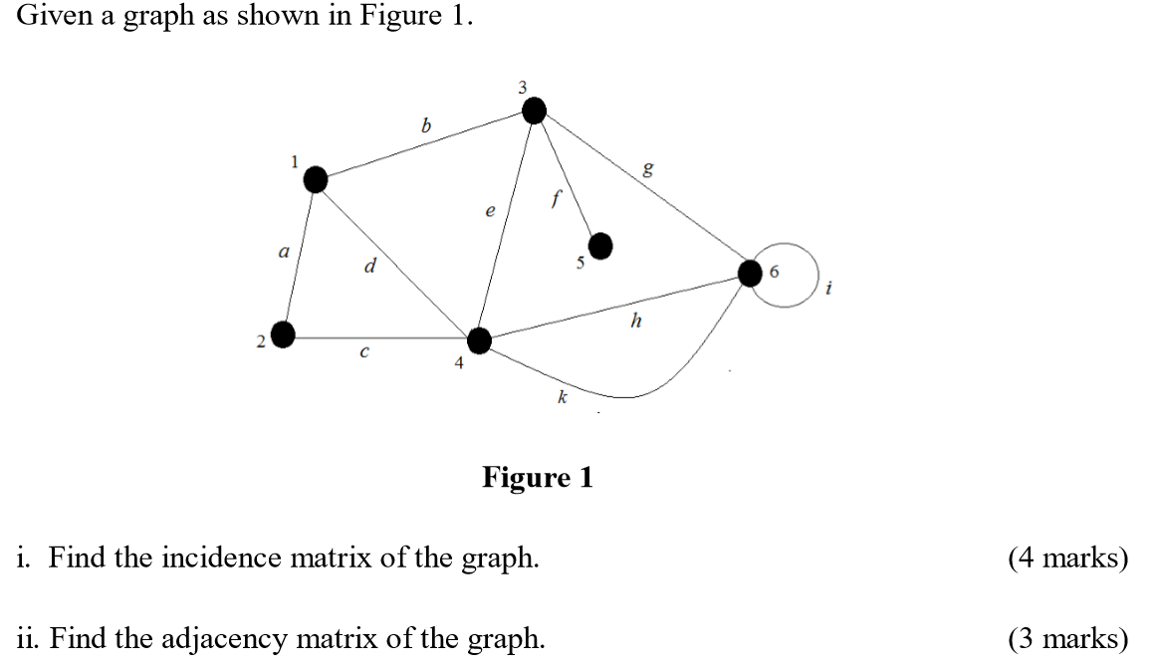
Exercise
Past Year 2015/2016

Slide 37
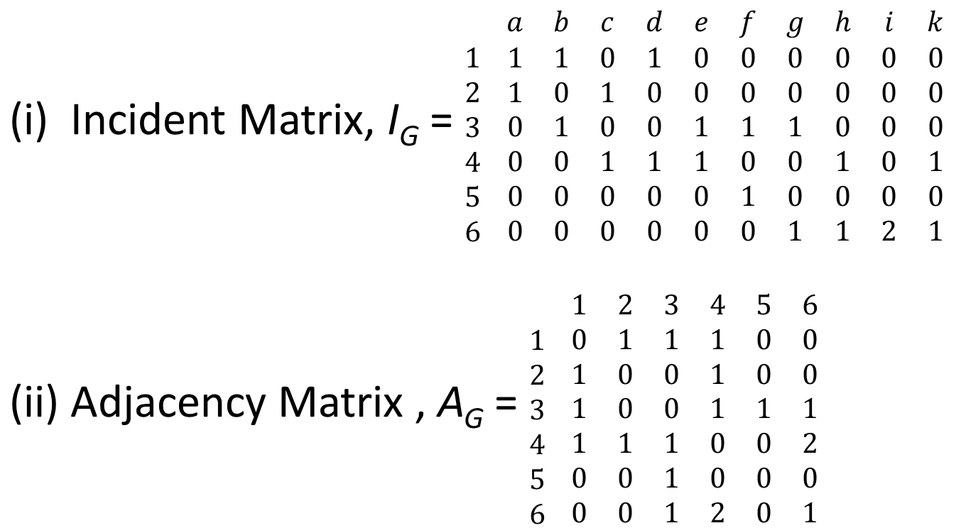
Exercise Solution
Past Year 2015/2016

Slide 38


Slide 39
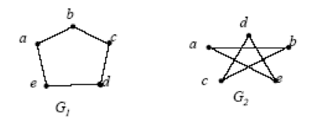
Are these two graphs (G₁ and G₂) are same?
When we say that 2 graphs are the same mean they are isomorphic to each other.

Slide 40
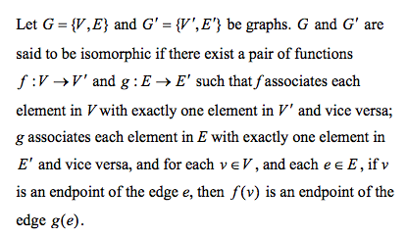
Definition

Slide 41
If two graphs is isomorphic, they must have:
the same number of vertices and edges,
the same degrees for corresponding vertices,
the same number of connected components,
the same number of loops and parallel edges,
both graphs are connected or both graph are not connected,
pairs of connected vertices must have the corresponding pair of vertices connected.
In general, it is easier to prove two graphs are not isomorphic by proving that one of the above properties fails.

Slide 42
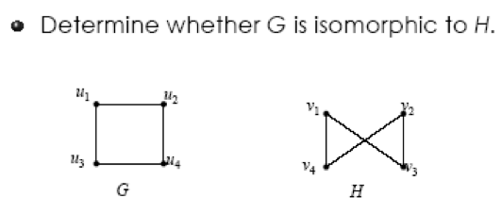
Example 1

Slide 43
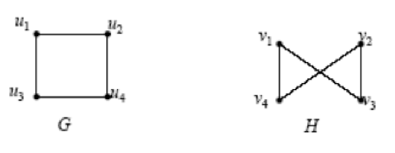
Example 1 - Solution
Both graphs are simple and have the same number of vertices and the same number of edges.
All the vertices of both graphs have degree 2.
Define f :U ➔V, where U = { u₁, u₂ , u₃, u₄} and V = { v₁, v₂ , v₃, v₄};
f(u₁) = v₁ ; f(u₂) = v₄ ; f(u₃) = v₃ ; f(u₄) = v₂ .

Slide 44
To verify whether G and H are isomorphic, we examine the adjacency matrix A_{G} with rows and columns labeled in the order u₁, u₂ , u₃, u₄ , and the adjacency matrix A_{H} with rows and columns labeled in the order v₁, v₂ , v₃, v₄ .

Slide 45
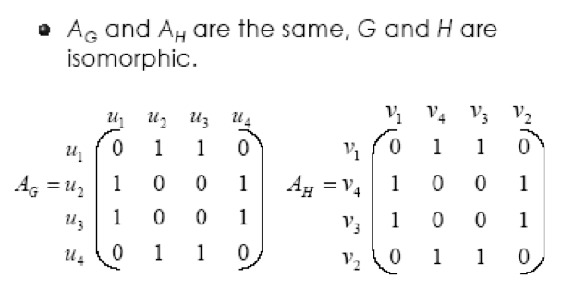

Slide 46
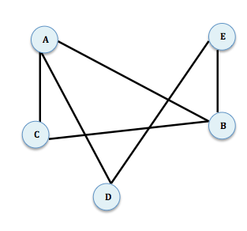
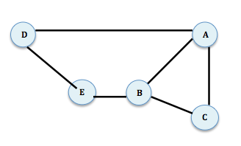
Exercise
Q: Show that the following two graphs are isomorphic.
G₁
G₂

Slide 47
Exercise Solution
G₁
G₂
Both have 5 vertices and 6 edges
Both are connected and simple graph
Both have 2 vertices with 3 degree and 3 vertices with 2 degree
f(A_{G1}) = A_{G2} f(B_{G1}) = B_{G2}
f(C_{G1}) = C_{G2} f(D_{G1}) = D_{G2}
f(E_{G1}) = E_{G2}
⸫ G₁ and G₂ are isomorphic

Slide 48
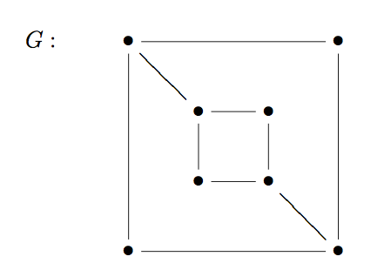
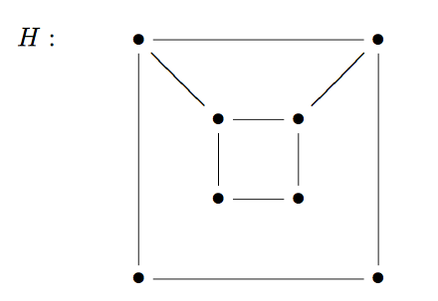
Exercise
Q: Is these two graphs are isomorphic?

Slide 49
Exercise Solution
Both have 8 vertices and 10 edges
Both are connected and simple graph
Both have 4 vertices with 3 degree and 4 vertices with 2 degree
However f:G → H cannot be defined
⸫ G and H are not isomorphic

Slide 50
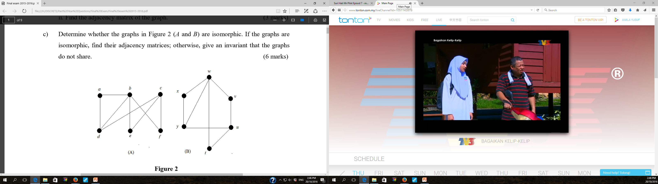
Exercise
Past Year 2015/2016

Slide 51
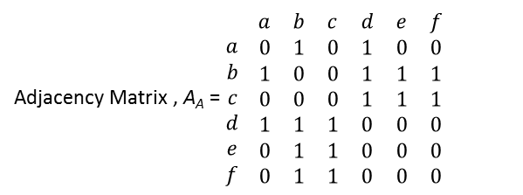
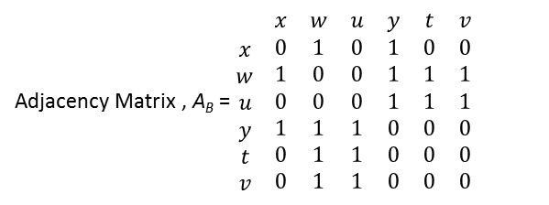
Exercise Solution
Past Year 2015/2016
Both have 6 vertices and 8 edges
Both are connected and simple graph
Both have 1 vertex with 4 degree, 2 vertices with 3 degree and 3 vertices with 2 degree
f(a_{A}) = x_{B} f(b_{A}) = w_{B}
f(c_{A}) = u_{B} f(d_{A}) = y_{B}
f(e_{A}) = t_{B} f(f_{A}) = v_{B}
⸫ A and B are isomorphic

Slide 52


Slide 53
Term and Description
A walk from v to w is a finite alternating sequence of adjacent vertices and edges of G. Thus a walk has the form
(v₀ , e₁ , v₁ , e₂ , v₂ ,……, v_{n-1} , e_{n} , v_{n} )
where the v’s represent vertices, the e’s represent
edges, v = v₀ , w = v_{n} , and for i = 1,2,…,n. v_{i-1} and v_{i} are the
endpoints of e_{i} .
A trivial walk from v to w consist of the single vertex v.
The length of a walk is the number of edges it has.

Slide 54
Term and Description (cont.)
A trail from v to w is a walk from v to w that does not contain a repeated edge.
A path from v to w is a trail from v to w that does not contain a repeated vertex.
A closed walk is a walk that start and ends at the same vertex.
A circuit/cycle is a closed walk that contains at least one edge and does not contain a repeated edge.
A simple circuit is a circuit that does not have any other repeated vertex except the first and the last.

Slide 55
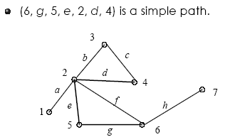
Example 1 – Trail & Path
(1, a, 2, b, 3, c, 4, d, 2, e, 5) is a trail.
(6, g, 5, e, 2, d, 4) is a path.
Note:
Trail: No repeated edge (can repeat vertex).
Path: No repeated vertex and edge.

Slide 56
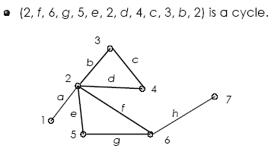
Example 2 – Cycle/circuit
Note: cycle –> start and end at same vertex, no repeated edge.

Slide 57
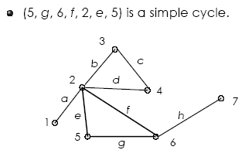
Example 3 – Simple Cycle
Note: Simple cycle –> start and end at same vertex, no repeated edge or vertex except for the start and end vertex.

Slide 58
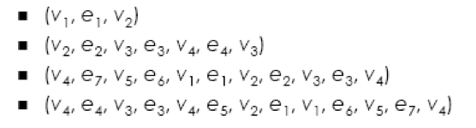
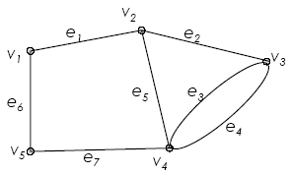
Exercise
Tell whether the following is either a walk, trail, path, cycle, simple cycle, closed walk or none of these.

Slide 59
Exercise - Solution
Tell whether the following is either a walk, trail, path, cycle, simple cycle, closed walk or none of these.
Trail
Walk; Trail
Simple cycle
Cycle

Slide 60


Slide 61
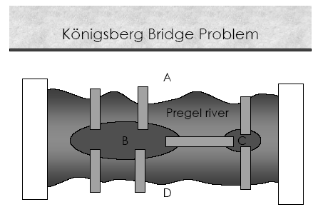
The town of Konigsberg in Prussia (now Kaliningrad in Russia) was built at a point where two branches of the Pregel River came together. It consisted of an island and some land along the river banks. These were connected by seven bridges as shown in figure below:

Slide 62

Problem: Starting at one land area, is it possible to walk across all of the bridges exactly once and return to the starting land area?

Slide 63

Solution: It is not possible to walk across all of the bridges exactly once and return to the starting land area. Therefore, two additional bridges have been constructed on the Pregel river.
C

Slide 64
Euler Circuit
Let G be a graph. An Euler circuit for G is a circuit that contains every vertex and every edges of G. That is, an Euler circuit for G is a sequence of adjacent vertices and edges in G that has at least one edges, starts and ends at the same vertex, uses every vertex of G at least once, and uses every edge of G exactly once.

Slide 65

Example 1

Slide 66
Euler Trail
Let G be a graph, and let v and w be two distinct vertices of G. An Euler trail from v to w is a sequence of adjacent vertices and edges that starts at v and ends at w, passes through every vertex of G at least once, and traverses every edge of G exactly once.

Slide 67

Example 2

Slide 68
Theorem - Euler
If G is a connected graph and every vertex has even degree, then G has an Euler circuit.
A graph has an Euler trail from v to w (v ≠ w) if and only if it is connected and v and w are the only vertices having odd degree.

Slide 69

Example 3
Vertex | 1 | 2 | 3 | 4 | 5 | 6 | 7
Degree | 2 | 4 | 4 | 4 | 2 | 2 | 4

Slide 70

Example 4
Vertex | 1 | 2 | 3 | 4 | 5 | 6
Degree | 2 | 4 | 2 | 4 | 2 | 2

Slide 71

Example 5
Vertex | 1 | 2 | 3 | 4 | 5 | 6
Degree | 2 | 3 | 3 | 2 | 2 | 2

Slide 72


Exercise
Q: Which of the following graphs has Euler circuit?
Justify your answer.
G₁
G₂

Slide 73
Exercise Solution
G₁
G₂
Q: Which of the following graphs has Euler circuit?
Justify your answer.
G₁ has Euler circuit since all vertices have even degree
G₂ does not has Euler circuit since 2 vertices (vertex a & b) have odd degree

Slide 74

Exercise
Past Year 2015/2016

Slide 75
Exercise Solution
Past Year 2015/2016
The graph does not has Euler circuit because 2 vertices (vertex 1 & 5) have odd degree
Hence, the graph has Euler path
1-b-2-a-3-c-1-d-4-f-4-e-3-k-5-g-4-h-6-i-5

Slide 76


Slide 77
Hamiltonian Circuits
Given a graph G, a Hamiltonian circuit for G is a simple circuit that includes every vertex of G (but doesn’t need to include all edges). That is, a Hamiltonian circuit for G is a sequence of adjacent vertices and distinct edges in which every vertex of G appears exactly once, except for the first and the last, which are the same.

Slide 78

Example
Sir William Rowan Hamilton marketed a puzzle in the mid-1800s in the form of dedocahedron.
Each corner bore the name of a city.
The problem was to start at any city, travel along the edges, visit each city exactly one time and return to the initial city.

Slide 79


(a): The graph
(b): Hamilton circuit

Slide 80

Example
This graph has a Hamilton circuit.
(1, a, 2, b, 3, f, 5, e, 4, k, 6, l, 7, m, 1)
- Visit each vertex just once.

Slide 81

Example
This graph does not contain Hamilton circuit.
(1, a, 2, b, 3, g, 6, f, 3, e, 5, d, 4, c, 3, h, 1)
- Vertex (3) has to be visited more than once.

Slide 82

Example
Question: Is this graph has Hamiltonian cycle?
Solution: (1, 4, 3, 2, 5, 4, 1)
- Vertex (4) has to be visited more than once.

Slide 83

Exercise
Question: Is this graph has Hamiltonian cycle?

Slide 84
Exercise - Solution
Manually check: This graph has Hamiltonian cycle.
Each vertex has to be visited only once.
For example: (1, 2, 3, 4, 5, 6, 7, 1)

Slide 85

Exercise
Question: Prove that this graph has Hamiltonian cycle.
a
b
c
h
d
g
e
f

Slide 86
Exercise - Solution
Question: Prove that this graph has Hamiltonian cycle.
a
b
c
h
d
g
e
f
Solution: (1, b, 3, c, 2, d, 4, f, 5, h, 1 )

Slide 87

Exercise

Slide 88
Exercise - Solution
Solution: (1, b, 6, g, 5, i, 4, h, 3, d, 2, a, 1)

Slide 89

Exercise
Past Year 2015/2016

Slide 90
Exercise Solution
Past Year 2015/2016
The graph has Hamiltonian cycle
7-f-3-c-4-d-1-a-2-e-6-k-5-m-8-h-7

Slide 91


Slide 92
Shortest Path
Let G be a weighted graph.
Let u and v be two vertices in G, and let P be a path in G from u to v.
The length of path P, written L(P), is the sum of the weights of all the edges on path P.
A shortest path from a vertex to another vertex is a path with the shortest length between the vertices.

Slide 93
Dijkstra’s Shortest Path Algorithm
1. S :=∅
2. N:= V
3. For all vertices, u ∈ V, u≠a, L(u):=∞
4. L(a):=0
http://en.wikipedia.org/wiki/Dijkstra%27s_algorithm

Slide 94
5. While z ∉ S do,
  5.a :Let v ∈ N be such that
  L(v)=min{L(u)|u ∈ N}
  5.b : S:= S ∈ {v}
  5.c : N:=N – {v}
5.d : For all w ∈ N such that there is an edge
from v to w
5.d.1: If L(v)+W[v,w] < L(w) then
L(w)=L(v)+W[v,w]

Slide 95
Example
What is the shortest path from a to z?
15
6
7
v4
v1
v6
3
3
7
4
5
a
v3
3
z
7
4
8
v5
v2
9

Slide 96
S=∅
N= {a,v1,v2,v3,v4,v5,v6,z}
15
∞
6
7
∞
v4
start
v1
v6
3
3
∞
7
4
∞
∞
5
a
v3
3
z
0
7
4
8
4
∞
v5
v2
9
∞

Slide 97
S={a}
N= {v1,v2,v3,v4,v5,v6,z}
L(a)+W[a,v4] <L(v4)
0+15=15 < ∞
L(v4)=15
15
a
15
6
7
∞
v4
start
v1
v6
3
3
∞
7
4
∞
∞
5
a
v3
3
z
0
7
4
8
∞
4
v5
v2
9
∞

Slide 98
S={a}
N= {v1,v2,v3,v4,v5,v6,z}
L(a)+W[a,v1] <L(v1)
0+3= 3 < ∞
L(v1)=3
15
a
15
6
7
∞
v4
start
v1
v6
3
3
a
3
7
4
∞
∞
5
a
v3
3
z
0
7
4
8
∞
4
v5
v2
9
∞

Slide 99
S={a}
N= {v1,v2,v3,v4,v5,v6,z}
L(a)+W[a,v2] <L(v2)
0+4= 4 < ∞
L(v2)=4
15
a
15
6
7
∞
v4
start
v1
v6
3
3
a
3
7
4
∞
∞
5
a
v3
3
z
0
7
4
8
∞
4
v5
a
4
v2
9

Slide 100
S={a}
N= {v1,v2,v3,v4,v5,v6,z}
choose v1
because
L(v1)=3 =
min{L(u)|u ∈ N}
15
a
15
6
7
∞
v4
start
v1
v6
3
3
7
4
∞
∞
a
3
5
a
v3
3
z
0
7
4
8
∞
4
v5
a
4
v2
9

Slide 101
S={a, v1}
N= {v2,v3,v4,v5,v6,z}
L(v1)+W[v1,v4]<L(v4)
3+6= 9 < 15
L(v4)=9
15
v1
9
6
7
∞
v4
start
v1
v6
3
3
7
4
a
3
∞
∞
5
a
v3
3
z
0
7
4
8
∞
4
v5
a
4
v2
9

Slide 102
S={a, v1}
N= {v2,v3,v4,v5,v6,z}
L(v1)+W[v1,v3]<L(v3)
3+7= 10 < ∞
L(v4)=10
15
v1
9
6
7
∞
v4
start
v1
v6
3
3
7
v1
10
4
a
3
∞
5
a
v3
3
z
0
7
4
8
∞
4
v5
a
4
v2
9

Slide 103
S={a, v1}
N= {v2,v3,v4,v5,v6,z}
choose v2
because
L(v2)=4 = min{L(u)|u ∈ N}
15
v1
9
6
7
∞
v4
start
v1
v6
3
3
7
v1
10
4
a
3
∞
5
a
v3
3
z
0
7
4
8
∞
4
v5
a
4
v2
9

Slide 104
S={a, v1, v2}
N= {v3,v4,v5,v6,z}
L(v2)+W[v2,v3]<L(v3)
4+8= 12 > 10
L(v3) remains the same.
15
v1
9
6
7
∞
v4
start
v1
v6
3
3
7
v1
10
4
a
3
∞
5
a
v3
3
z
0
7
4
8
∞
4
v5
a
4
v2
9

Slide 105
S={a, v1, v2}
N= {v3,v4,v5,v6,z}
L(v2)+W[v2,v5]<L(v5)
4+4= 8 < ∞
L(v5)=8
15
v1
9
6
7
∞
v4
start
v1
v6
3
3
7
v1
10
4
a
3
∞
5
a
v3
3
z
0
7
4
8
4
v2
8
v5
a
4
v2
9

Slide 106
S={a, v1, v2}
N= {v3,v4,v5,v6,z}
L(v2)+W[v2, z]<L(z)
4+9= 13 < ∞
L(z)=13
15
v1
9
6
7
∞
v4
start
v1
v6
3
3
7
v1
10
4
a
3
5
v2
13
a
v3
3
z
0
7
4
8
4
v2
8
v5
a
4
v2
9

Slide 107
S={a, v1, v2}
N= {v3,v4,v5,v6,z}
choose v5
because
L(v5)=8 = min{L(u)|u ∈ N}
15
v1
9
6
7
∞
v4
start
v1
v6
3
3
7
v1
10
4
a
3
5
v2
13
a
v3
3
z
0
7
4
8
4
v2
8
v5
a
4
v2
9

Slide 108
S={a, v1, v2, v5}
N= {v3,v4, v6,z}
L(v5)+W[v5, v4]<L(v4)
8+3= 11 > 9
L(v4) remains the same
15
v1
9
6
7
∞
v4
start
v1
v6
3
3
7
v1
10
4
a
3
5
v2
13
a
v3
3
z
0
7
4
8
4
v2
8
v5
a
4
v2
9

Slide 109
S={a, v1, v2, v5}
N= {v3,v4, v6,z}
L(v5)+W[v5, z] <L(z)
8+7= 15 > 13
L(z) remains the same
15
v1
9
6
7
∞
v4
start
v1
v6
3
3
7
v1
10
4
a
3
5
v2
13
a
v3
3
z
0
7
4
8
4
v2
8
v5
a
4
v2
9

Slide 110
S={a, v1, v2, v5}
N= {v3,v4, v6,z}
choose v4
because
L(v4)=9 = min{L(u)|u ∈ N}
15
v1
9
6
7
∞
v4
start
v1
v6
3
3
7
v1
10
4
a
3
5
v2
13
a
v3
3
z
0
7
4
8
4
v2
8
v5
a
4
v2
9

Slide 111
S={a, v1, v2, v5,v4}
N= {v3,v6,z}
L(v4)+W[v4, v6]<L(v6)
9+7= 16 < ∞
L(v6) = 16
15
v1
9
6
7
v4
16
v4
start
v1
v6
3
3
7
v1
10
4
a
3
5
v2
13
a
v3
3
z
0
7
4
8
4
v2
8
v5
a
4
v2
9

Slide 112
S={a, v1, v2, v5,v4}
N= {v3, v6, z}
choose v3
because
L(v3)=10 = min{L(u)|u ∈ N}
15
v1
9
6
7
v4
16
v4
start
v1
v6
3
3
7
v1
10
4
a
3
5
v2
13
a
v3
3
z
0
7
4
8
4
v2
8
v5
a
4
v2
9

Slide 113
S={a, v1, v2, v5,v4, v3}
N= {v6,z}
L(v3)+W[v3, v6]<L(v6)
10+4= 14 < 16
L(v6) = 14
15
v1
9
6
7
v3
14
v4
start
v1
v6
3
3
7
v1
10
4
a
3
5
v2
13
a
v3
3
z
0
7
4
8
4
v2
8
v5
a
4
v2
9

Slide 114
S={a, v1, v2, v5,v4,v3}
N= {v6,z}
L(v3)+W[v3, z] <L(z)
10+5= 15 > 13
L(z) remains the same
15
v1
9
6
7
v3
14
v4
start
v1
v6
3
3
7
v1
10
4
a
3
5
v2
13
a
v3
3
z
0
7
4
8
4
v2
8
v5
a
4
v2
9

Slide 115
S={a, v1, v2, v5,v4,v3}
N= {v6,z}
choose z
because
L(z)=13 = min{L(u)|u ∈ N}
15
v1
9
6
7
v3
14
v4
start
v1
v6
3
3
7
v1
10
4
a
3
5
v2
13
a
v3
3
z
0
7
4
8
4
v2
8
v5
a
4
v2
9

Slide 116
S={a, v1, v2, v5,v4,v3,z}
N= {v6}
The loop terminates because z ∈ S
15
v1
9
6
7
v3
14
v4
start
v1
v6
3
3
7
v1
10
4
a
3
5
v2
13
a
v3
3
z
0
7
4
8
4
v2
8
v5
a
4
v2
9

Slide 117
Shortest path from a to z is a -> v2-> z, with the length 13.
15
v1
9
6
7
v3
14
v4
start
v1
v6
3
3
7
v1
10
4
a
3
5
v2
13
a
v3
3
z
0
7
4
8
4
v2
8
v5
a
4
v2
9

Slide 118

Table – Djikstra Algorithm

Slide 119

Exercise
Q: Given a weighted digraph, find the shortest path from S to T, using Djikstra Algorithm.
Note: Weights are arbitrary numbers (i.e., not necessarily distances).

Slide 120
Exercise - Solution
i | S | N | L(S) | L(A) | L(B) | L(C) | L(D) | L(E) | L(F) | L(T)
0 | Ø | {S,A,B,C,D,E,F,T} | 0 | ∞ | ∞ | ∞ | ∞ | ∞ | ∞ | ∞
1 | {S} | {A,B,C,D,E,F,T} | 0 | 9 | 14 | 15 | ∞ | ∞ | ∞ | ∞
2 | {S,A} | {B,C,D,E,F,T} | 0 | 9 | 14 | 15 | 33 | ∞ | ∞ | ∞
3 | {S,A,B} | {C,D,E,F,T} | 0 | 9 | 14 | 15 | 32 | 44 | ∞ | ∞
4 | {S,A,B,C} | {D,E,F,T} | 0 | 9 | 14 | 15 | 32 | 35 | ∞ | 59
5 | {S,A,B,C,D} | {E,F,T} | 0 | 9 | 14 | 15 | 32 | 34 | ∞ | 51
6 | {S,A,B,C,D,E} | {F,T} | 0 | 9 | 14 | 15 | 32 | 34 | 45 | 40
7 | {S,A,B,C,D,E,T} | {F} | 0 | 9 | 14 | 15 | 32 | 34 | 45 | 40

Slide 121
Exercise Solution
The shortest path from S to T, having weight 40, is S – B – D – E – T
Note: Weights are arbitrary numbers (i.e., not necessarily distances).

Slide 122

Exercise
Past Year 2015/2016

Slide 123
Exercise Solution
Past Year 2015/2016
i | S | N | L(A) | L(B) | L(C) | L(D) | L(E) | L(F) | L(G) | L(H)
0 | Ø | {A,B,C,D,E,F,G,H} | 0 | ∞ | ∞ | ∞ | ∞ | ∞ | ∞ | ∞
1 | {A} | {B,C,D,E,F,G,H} | 0 | 1 | 2 | ∞ | ∞ | ∞ | ∞ | ∞
2 | {A,B} | {C,D,E,F,G,H} | 0 | 1 | 2 | 6 | 4 | ∞ | ∞ | ∞
3 | {A,B,C} | {D,E,F,G,H} | 0 | 1 | 2 | 5 | 4 | 6 | ∞ | ∞
4 | {A,B,C,E} | {D,F,G,H} | 0 | 1 | 2 | 5 | 4 | 6 | 11 | ∞
5 | {A,B,C,E,D} | {F,G,H} | 0 | 1 | 2 | 5 | 4 | 6 | 11 | ∞
6 | {A,B,C,E,D,F} | {G,H} | 0 | 1 | 2 | 5 | 4 | 6 | 11 | 8
7 | {A,B,C,E,D,F,H} | {G} | 0 | 1 | 2 | 5 | 4 | 6 | 11 | 8
Minimum distance from city A to city H is 8
The shortest path is A – C – F - H

